Slide 1


INTRODUCTION TO AI K24AI11
Crop Recommendation System
Team:
A recommendation system that suggests the best crop based on soil and weather conditions using classification techniques.
SHASHANK (202401100300225)
SHAURYA PRATAP SINGH (202401100300229)
TUSHAR SHAMA (202401100300266)
YATHARTH (202401100300287)

Slide 2
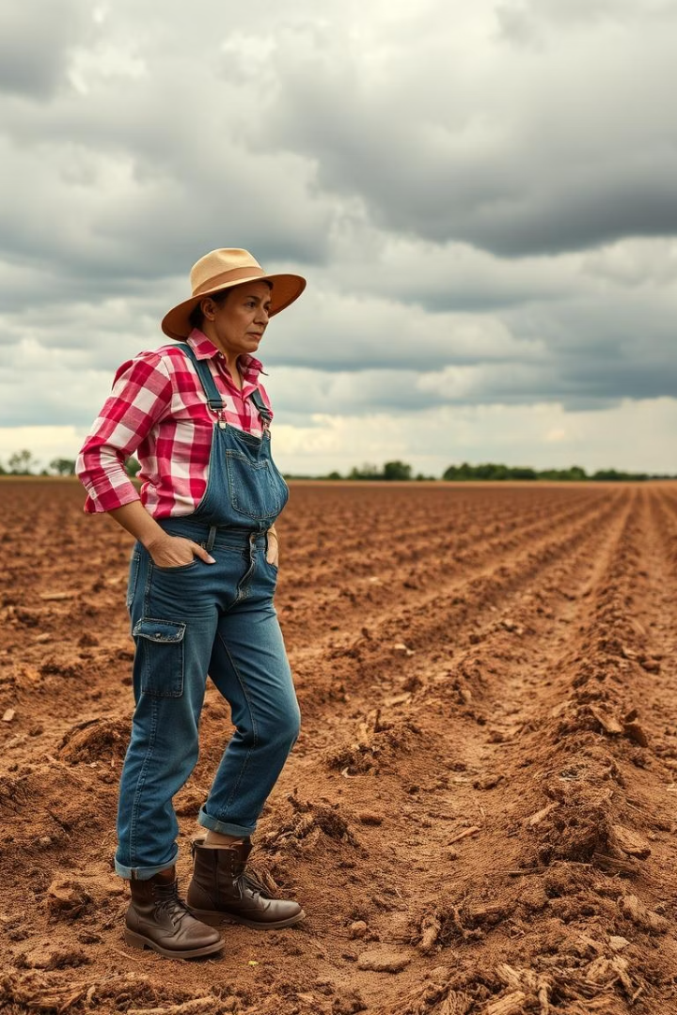
Problem Statement: The Farmer's Dilemma
Challenges
Impact
Farmers struggle with crop choices amid soil and climate changes.
Traditional methods cause waste and reduce crop yields.
Economic Loss
$31 billion lost yearly in US due to poor planting decisions.

Slide 3
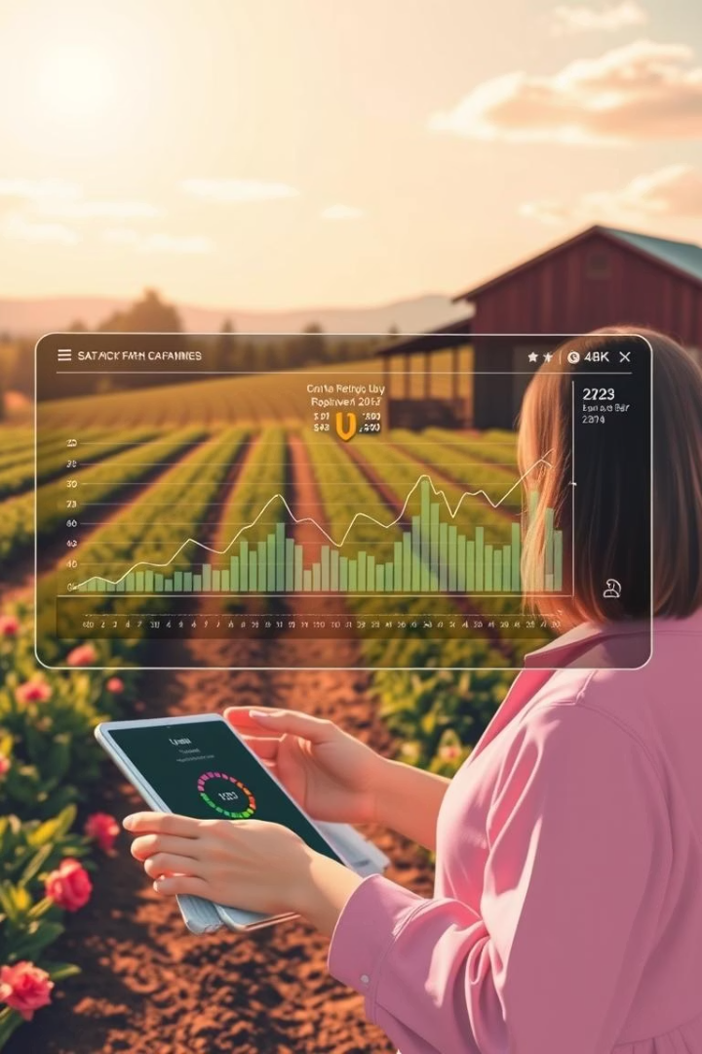
Introduction: Intelligent Crop Recommendation
What It Is
Benefits
Data-driven systems guide crop selection using machine learning.
Boost yields by up to 30%, minimize resource waste significantly.
Market Potential
Precision agriculture market projected at $1.5B by 2027.

Slide 4
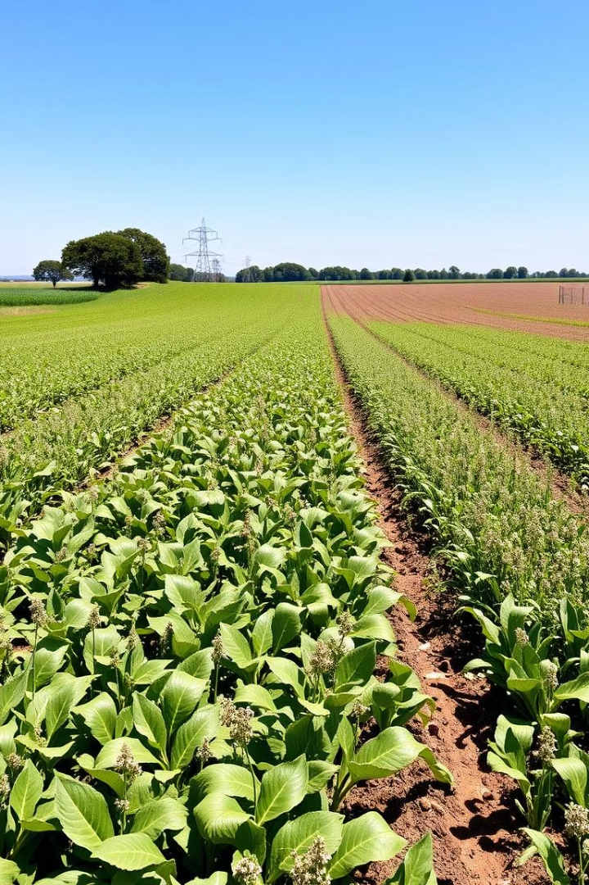
Crop Recommendation System using Classification Techniques
Optimizing Agricultural Yields with Machine Learning

Slide 5
Methodology: Classification Techniques
Data Collection
Algorithms
Soil: pH, nutrients
Random Forest: Ensemble, high accuracy
Weather: temperature, rainfall
SVM: Handles high-dimensional data
Crop yield records
KNN: Simple, interpretable

Slide 6
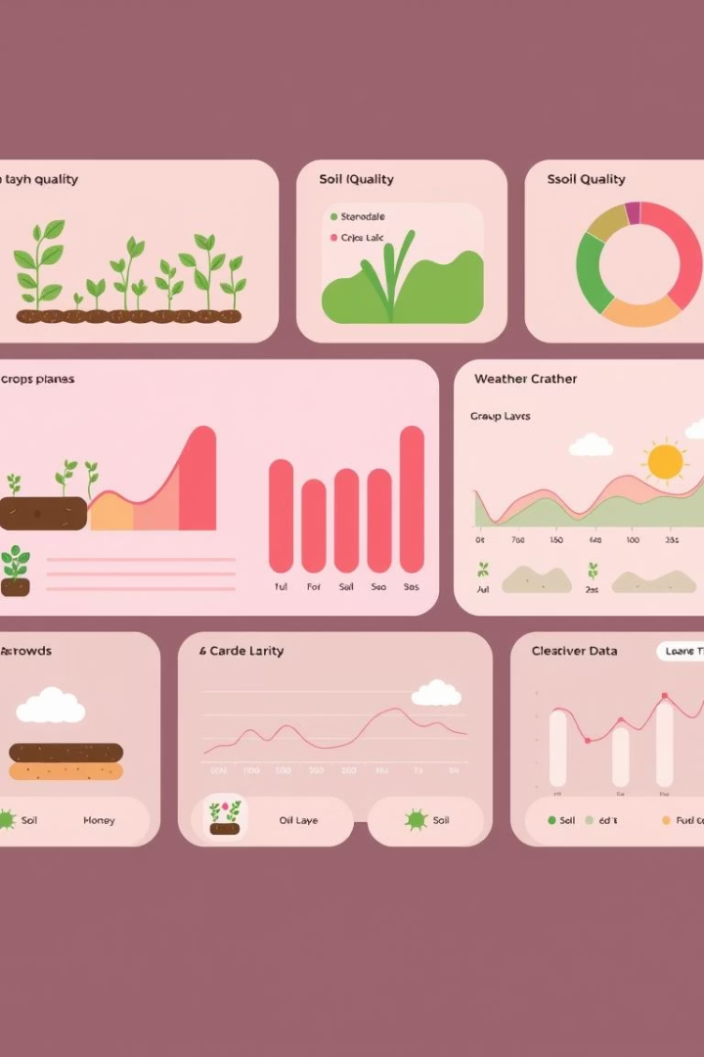
Dataset and Features
Sources
Key Features
USDA NASS crop yield data
Soil pH: 6.0–7.5
SSURGO soil properties
Rainfall: 500–1500 mm/year
NOAA weather data
Temperature: 15–30°C
Scale
Over 10,000 data points from 10 major crops

Slide 7
Model Training and Evaluation
Training Setup
Metrics
Validation
Used 80% data for training, 20% for testing
Accuracy
Cross-validation ensures robustness of models
Precision
Recall
F1-Score

Slide 8





System Architecture
Data Input
Preprocessing
Model Selection
Output
User submits soil, weather, and location info
Clean and normalize data, extract features
Identify the best classification model
Top 3-5 crop recommendations with yields

Slide 9
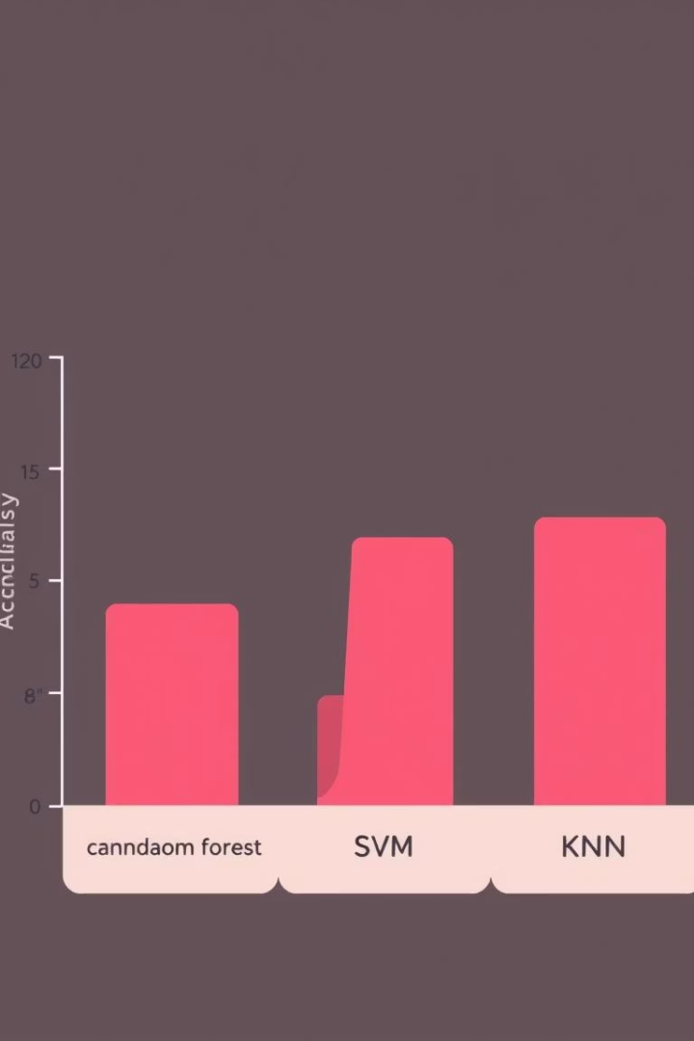
Results: Performance Comparison
Model
Accuracy
F1-Score
Random Forest
92%
0.91
SVM
88%
0.87
KNN
85%
0.84
Random Forest excels at handling complex, nonlinear data patterns.

Slide 10
Results: Sample Recommendations
Input Scenario
Top Crops
Soil pH 6.5, Rainfall 1200 mm/year, Temperature 25°C
Rice: 5.5 tons/hectare
Wheat: 4.0 tons/hectare
Maize: 6.0 tons/hectare

Slide 11

Future Work: Enhancements
Real-time Market Data
Remote Sensing
Integrate crop price info for profitability analysis
Use satellite images for soil and crop monitoring
Mobile App
Expanded Coverage
Enable farmers to access recommendations in the field
Add support for more crops and diverse regions

Slide 12


Slide 13
INTRODUCTION TO AI K24AI11

